Slide 1
ANALYSIS REPORT ON EMPOLYEE ATRRITION CASE

Slide 2
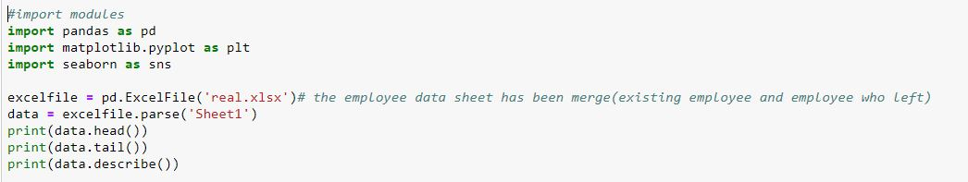
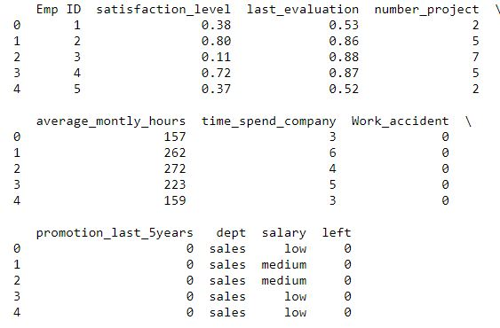
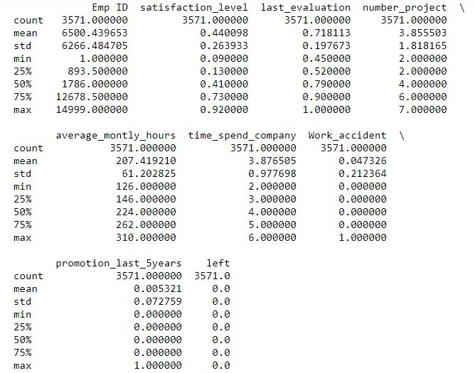
OBSERVATIVE/EXPLORATORY Analysis we do some Exploratory Data Analysis, where we summarize characteristics of data such as pattern, trends, outliers, and hypothesis testing using descriptive statistics and visualization.

Slide 3
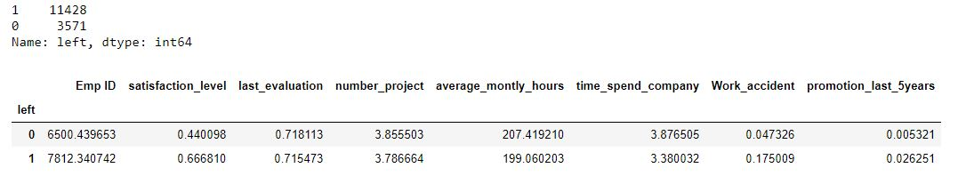
INSIGHT ON DATA
we have two types of employee one who stayed and another who left the company. So, we divided them into two groups and compare their characteristics.
We can see that Employees who left the company had low satisfaction level, low promotion rate in the last 5 years, and worked more compare to who are still with the company. I believe we have found a little bit of clue why they left.
They say picture says a thousand words, so lets VISUALIZE THE DATA

Slide 4

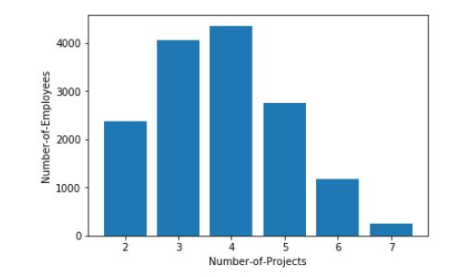
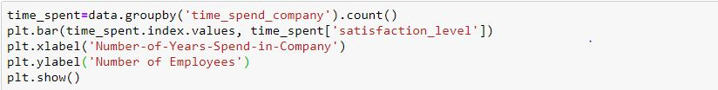
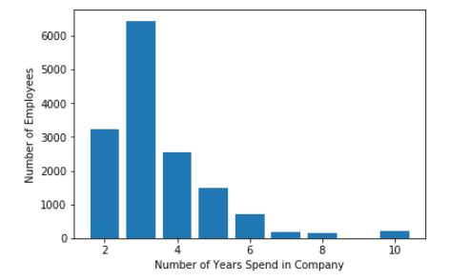
So we can see all the employees were involved in at least 3-4 project.
Lets check the time they spent in the company.
So we can see that they spent at least 3 years in the company.
And wow what huge gap between 3-4 years. They begin to leave, in year 4. That when they get dissatisfied with the job
Because maybe they are over worked.

Slide 5
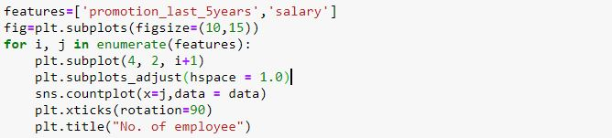
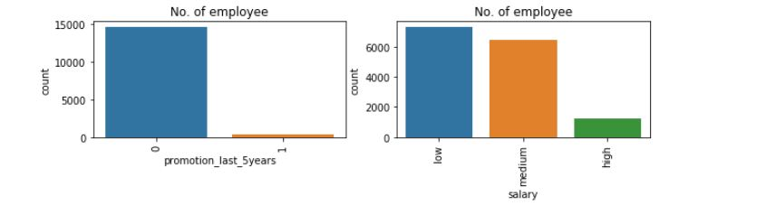
Lets visualize there promotion rate in the last 5 years.
We can see that the number of employees that have not been promoted is at a high rate. Another clue why the left.
Lets check if these employee are paid well.
most of these employee earn low or medium salary.

Slide 6
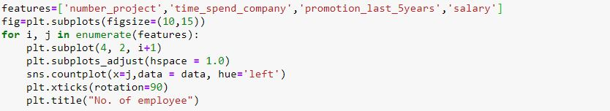
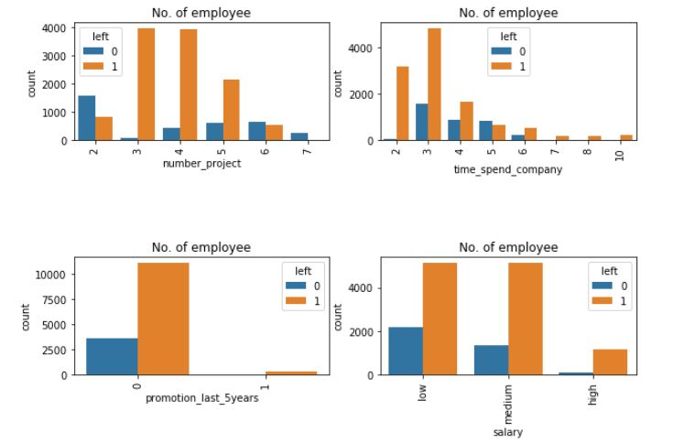
Lets see the number of project and how they both handle and react to it.
look at the data on the existing employee. We can see that they are only comfortable with 3-4 project, as soon as it gets to 5, they begin to leave, and when it gets to 6 project , they are all gone. They sure don’t like to be overworked.
We can see that after 5years without promotion they begin to leave.
Most of them spent 2-4 years before they leave.

Slide 7
What we know so far
The employee don’t like to be over worked. Project range between 3-5 seems to be ok for them, the don’t like to be over worked.
we also noticed that they will quit if not promoted within 5 years.
Most off the employee that left are low salary earners.
We can also tell that the 3 year mark is very important in their life. That’s the point when they decide, if they want to leave the company. So in that time we either increase their salary, promote them, or reduce their workload.
So we can see that satisfaction and performance is part of the reason they left.

Slide 8
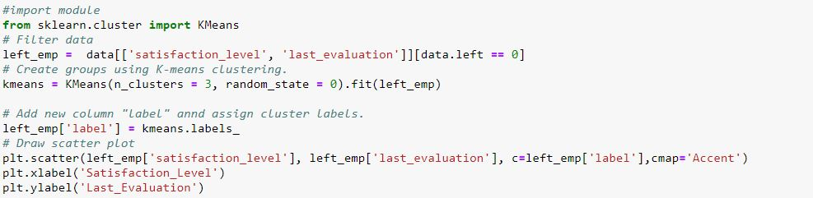
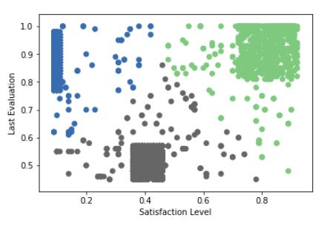
Cluster analysi Lets group the esmployees that left into clusters and see the type of employee they are. We will use two variables, satisfaction level and last evaluation.
Am going to use tableau public and sklearn.cluster and import Kmeans algorithm to get the details in the employee that left.

Slide 9
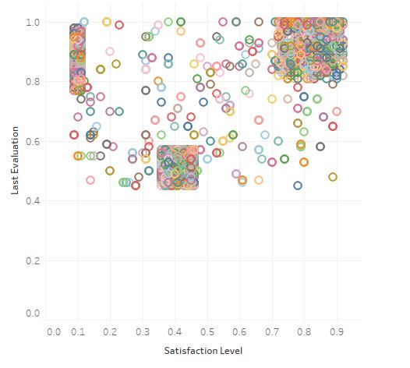
High Satisfaction and High Evaluation(Shaded in green color). These set of people got better offer from some where else, they are low salary earner with no promotion in the last 5 years. they wanted more. That’s why they left.
Low Satisfaction and High Evaluation(Shaded in blue color). These set of people are valued by the company but are not satisfied with the way they are treated. they handle 5-7 project, have spent 4-5years with the company and are paid low salary. they are overworked and they haven’t been promoted in last five years, that’s why they are dissatisfied.
Moderate Satisfaction and moderate Evaluation (Shaded in grey color).these people are somewhere in between, they are not motivated by they job. They handle an average of 2 project and salary is low or medium. They want more responsibility.

Slide 10
Preparing data for building the model.
So with what we know on those employees that left, I think we can build a model that can predict type of employee that is likely to leave the company.
Before we build a model we have to organize the data. We have some attribute that has string values such as salary and department. We need them to build a model so we can not ignore them. We have to find a way to encode strings to numeric.
Salary column's value can be represented as low:0, medium:1, and high:2.
We can either do these manually or we can use label encoding which is a function of sklearn.
So we then group the attributes in to “x” and “y”. “x” been the input and “y” been the outcome.
input: will include satisfaction_level, last_evaluation, number_project, average_montly_hours, time_spend_company, Work_accident, promotion_last_5years, Departments , salary.
outcome: will be the “left”.
The we split the data into training and testing sets. 70:30 proportion. With 30% been the test data.

Slide 11
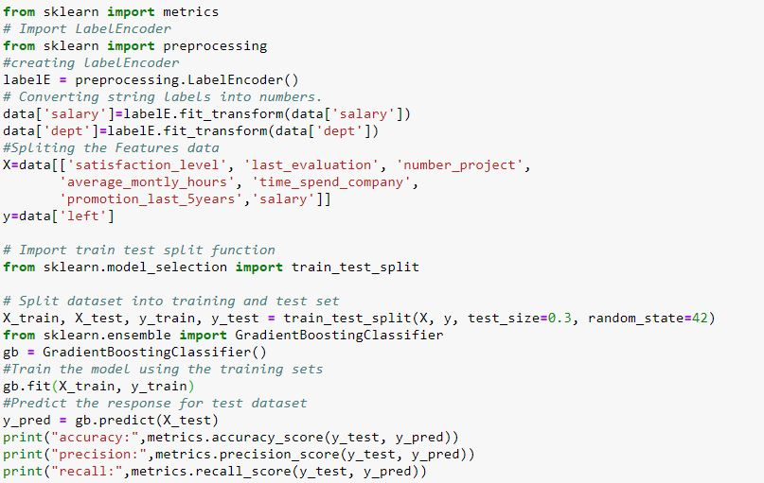

MODEL OUTPUT

Slide 12
Evaluating Model Performance
We check the Accuracy, to see, how often the classifier is correct?
And wow the model’s accuracy is 97%
We have to check for the precision, cause I want to know, how precise the model’s prediction is?
Precision is at 95%,
Recall: the gradient booster can identity any employee who left in the test set 92% of the time.

Slide 13
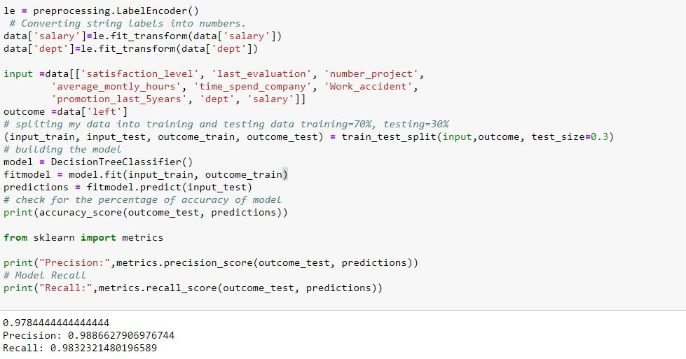
I want to cross check these result with a decision tree algorithm just to be sure. The decision tree model brought out these result;
I think our model is working just fine.

Slide 14
CONCLUSION
What type of employees are leaving:
employees that are not promoted within 5 years and have high evaluation, have spent at least 4-5years.
Employee that are engaged in 5-7 project tends and are paid low income,
Employee that are not handling 1-2 project don’t feel engaged enough.
Employee that are prone to leave:
The employee that are doing 5-6 project are going to leave,
The ones that have not been promoted in within 5 year and have high evaluation will leave.
Employee with high evaluation and low salary will leave.
Employee with low project(1-2) with definitely leave.

